Slide 1
0-to-hero
07/10 Mentors <> 07/10 Sessions

Slide 2
Elkhan Shahverdi
Senior Software Engineer at Insparx Gmbh
https://www.linkedin.com/in/elkhan-shahverdi-59356166/
shahverdiyev90@gmail.com
Twitter: @shahverdiyev90
Ankara University – Computer Engineering (BSc)
University of Tartu – Software Engineering (MSc)

Slide 3
Estonia
Study:
https://www.studyinestonia.ee/en
Work:
https://www.workinestonia.com/
https://devhunt.ee

Slide 4
Stream Processing
Agenda
Derived data
Stream processing
Apache Flink Architecture
Benchmark of Stream Processing engines.

Slide 5
Derived Data
Network Monitoring and Traffic engineering
Sensor logs
Telecom call-detail records
Mobile Application logs
Social network trends
Website logs and clickstreams
Other massive data sets…
Notes:
Nowadays, technologies surrounded us generate the huge amount of data.
Devices which connected to the network creates it's network logs.
Traffic sensors generate its logs. While we are walking, phone in our pockets creates record while connecting and disconnecting the base station. We can give such kind of more example as Mobile applications, Websites, and social networks.
All of this data is important the most of them must be processed. But some of this derived data are making more value if it has been treated in real-time (in a milliseconds after it appeared). Importance of processing unbound data produce Stream Processing as a solution.

Slide 6
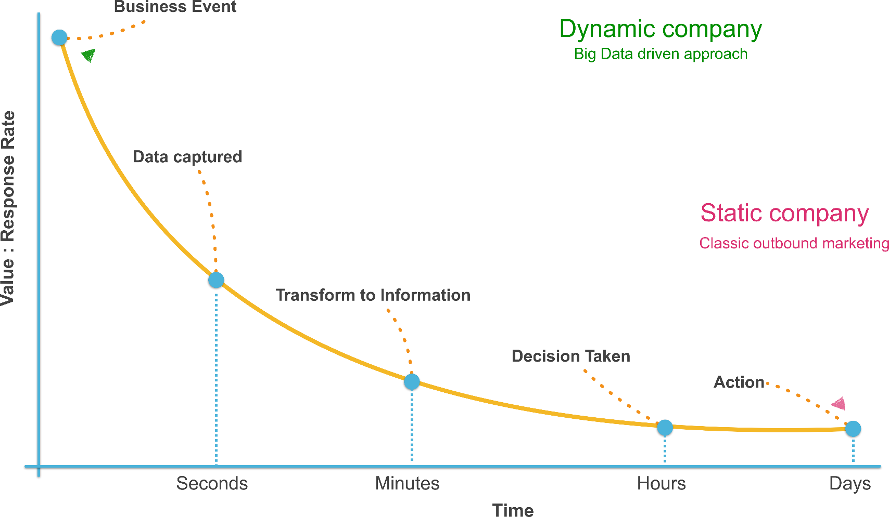
Importance of real-time processing
Notes:
Data lose value quickly overtime.

Slide 7
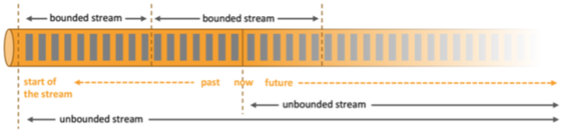
What is Stream Processing
Processing data in motion
Querying continuous data stream
Detect conditions fast within a small time period
Related synonyms for Stream Processing are: Real-time analytics, Streaming analytics, Complex Event Processing, Event Processing

Slide 8
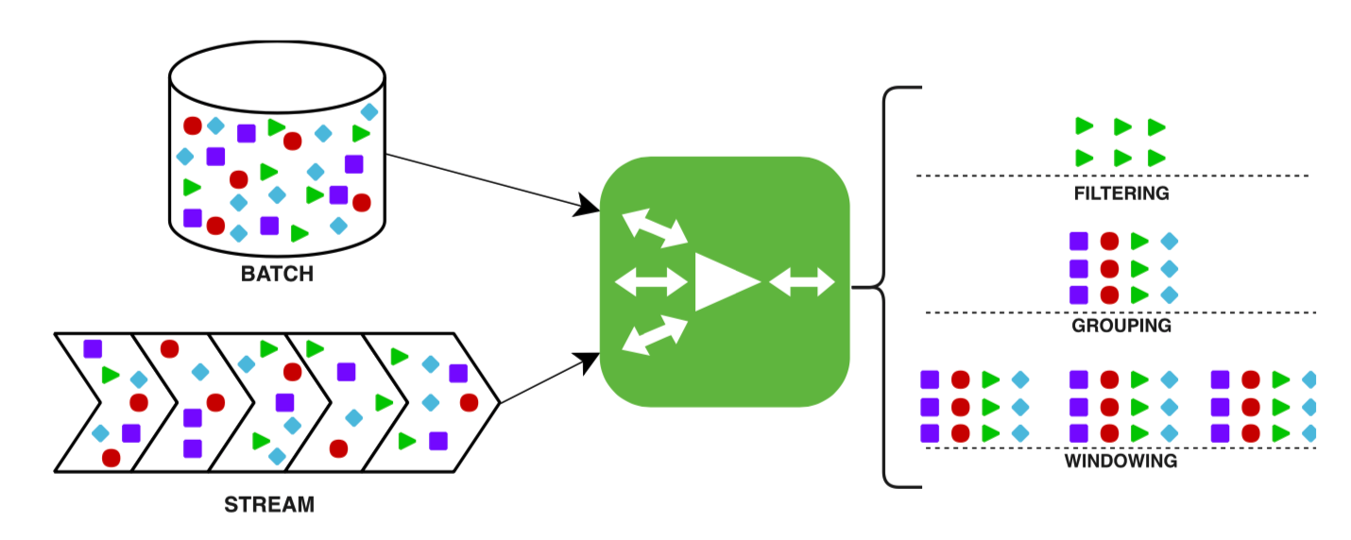
What is Stream Processing doing?
Sourcing
Filtering
Transformation
Map-Reduce
Grouping
Windowing
Stream-Stream Join
Stream-Table Join
Sink

Slide 9
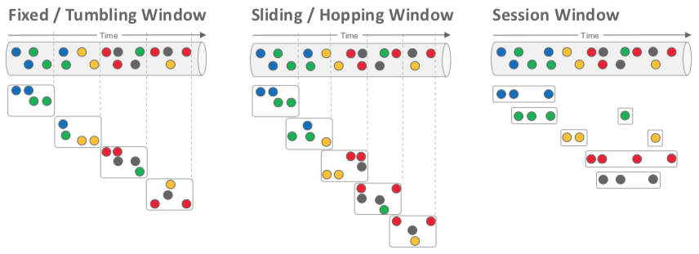
Windowing

Slide 10
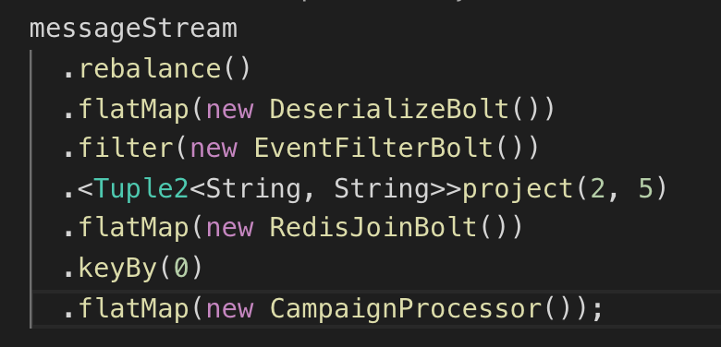
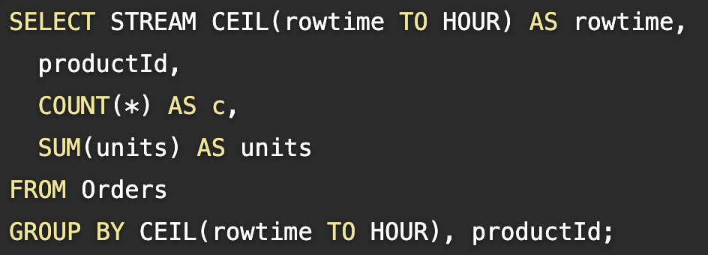
API
Programmatic
Streaming SQL

Slide 11
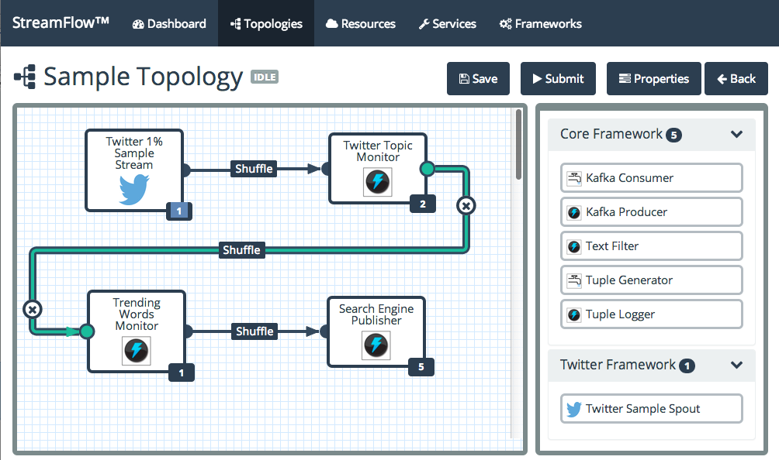
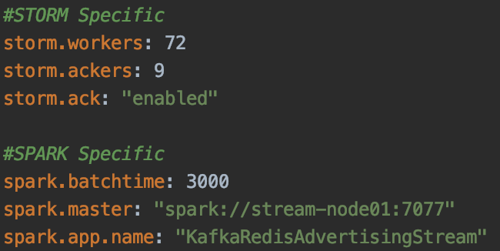
API
GUI-based / drag and drop
Declarative (Json, Yaml)

Slide 12













Stream Processing Engines

Slide 13
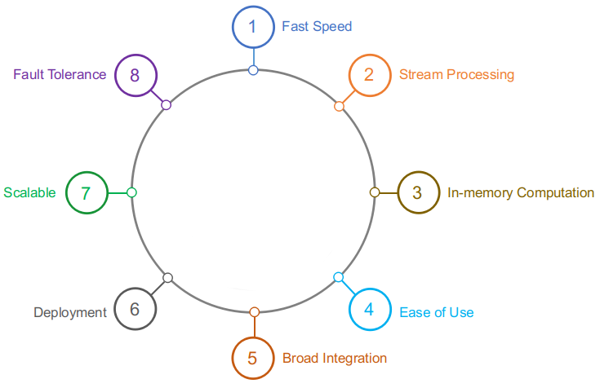
Features of Stream Processing Engines

Slide 14
Delivery Guarantees
At most once - fire and forget
At least once
Exactly once

Slide 15
Apache Flink Architecture
Program
It is a piece of code, which you run on the Flink Cluster.
Client
It is responsible for taking code (program) and constructing job dataflow graph, then passing it to JobManager.
Job Manager
Also called masters.
Task Manager
Also called workers or slaves.
Notes:
Flink builds batch processing on top of the streaming engine, overlaying native iteration support, managed memory, and program optimization.
Program It is a piece of code, which you run on the Flink Cluster.
Client It is responsible for taking code (program) and constructing job dataflow graph, then passing it to JobManager. It also retrieves the Job results.
JobManager Also called masters. They coordinate the distributed execution. They schedule tasks, coordinate checkpoints, coordinate recovery on failures, etc. After receiving the Job Dataflow Graph from Client, it is responsible for creating the execution graph. It assigns the job to TaskManagers in the cluster and supervises the execution of the job.
There is always at least one Job Manager. A high-availability setup will have multiple JobManagers, one of which one is always the leader, and the others are standby.
TaskManager Also called workers or slaves. They execute the tasks that have been assigned by JobManager (or more specifically, the subtasks) of a dataflow, and buffer and exchange the data streams. All the TaskManagers run the tasks in their separate slots in specified parallelism. It is responsible to send the status of the tasks to JobManager.

Slide 16
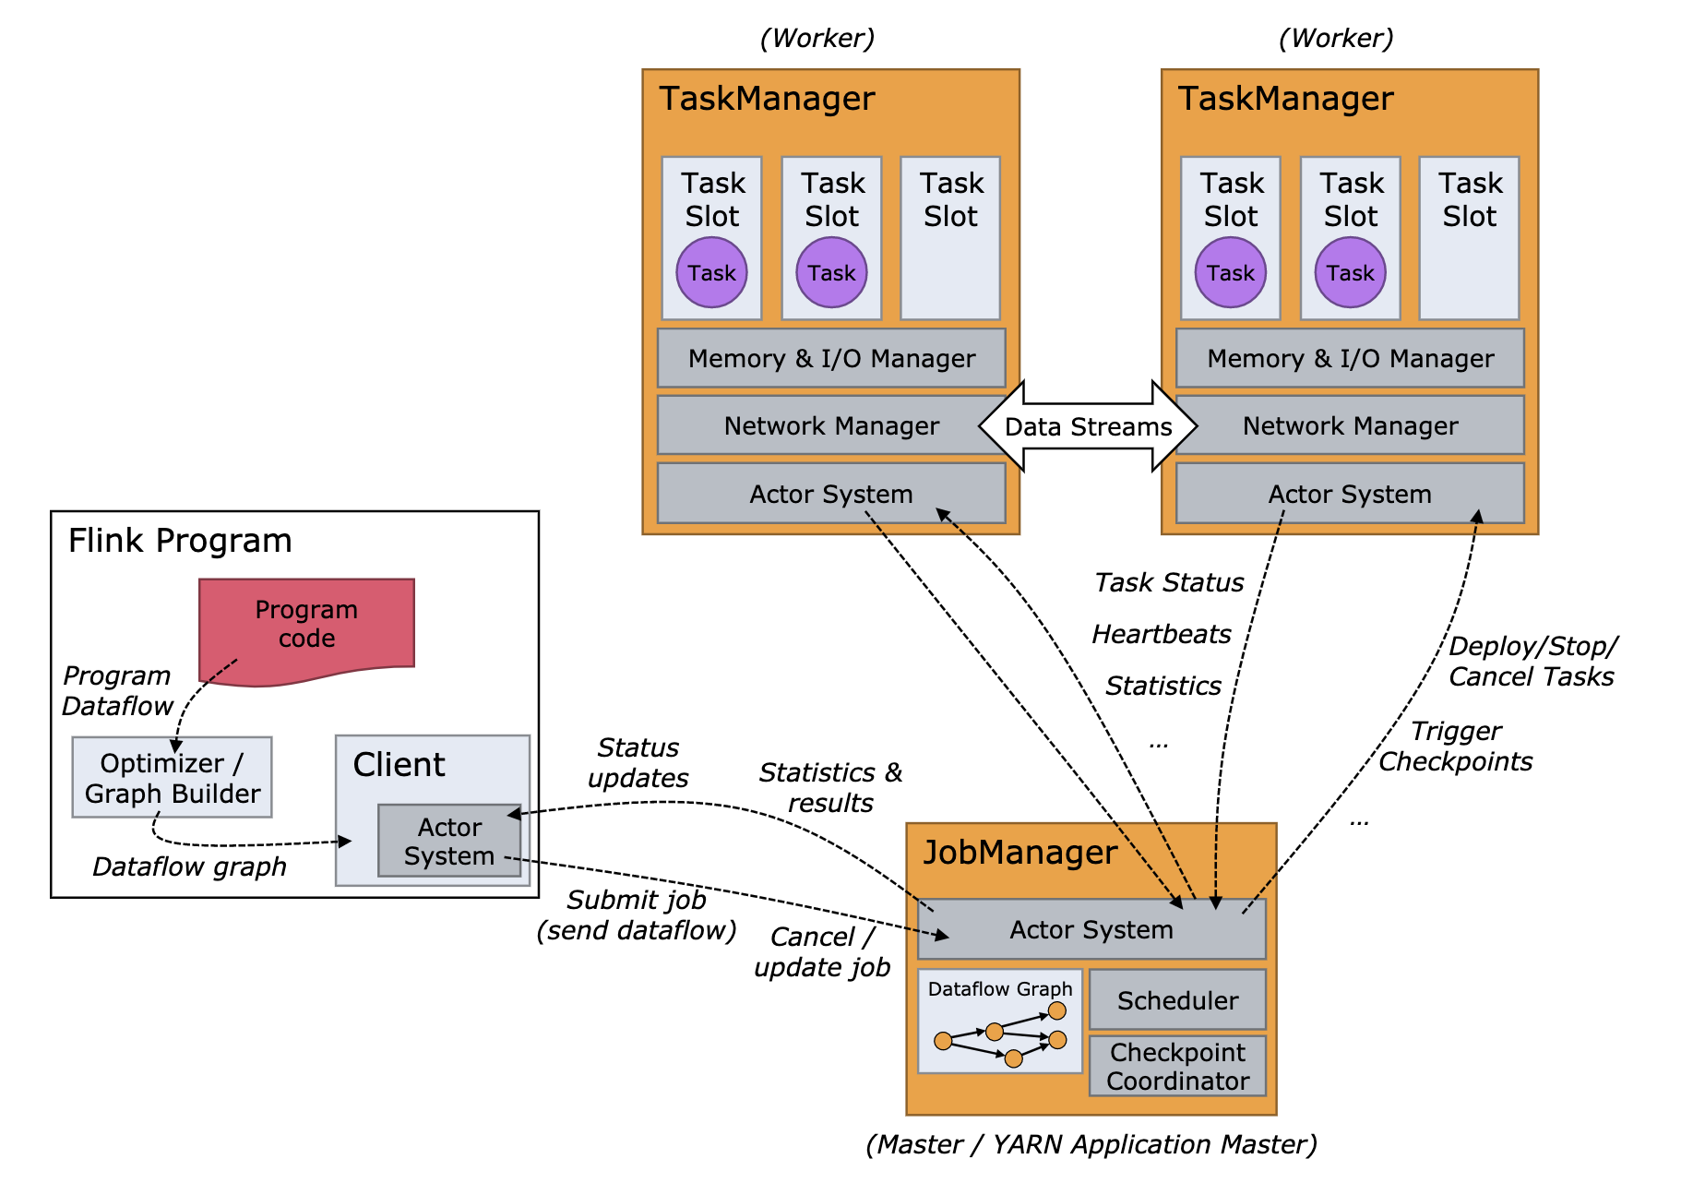
Apache Flink Architecture

Slide 17
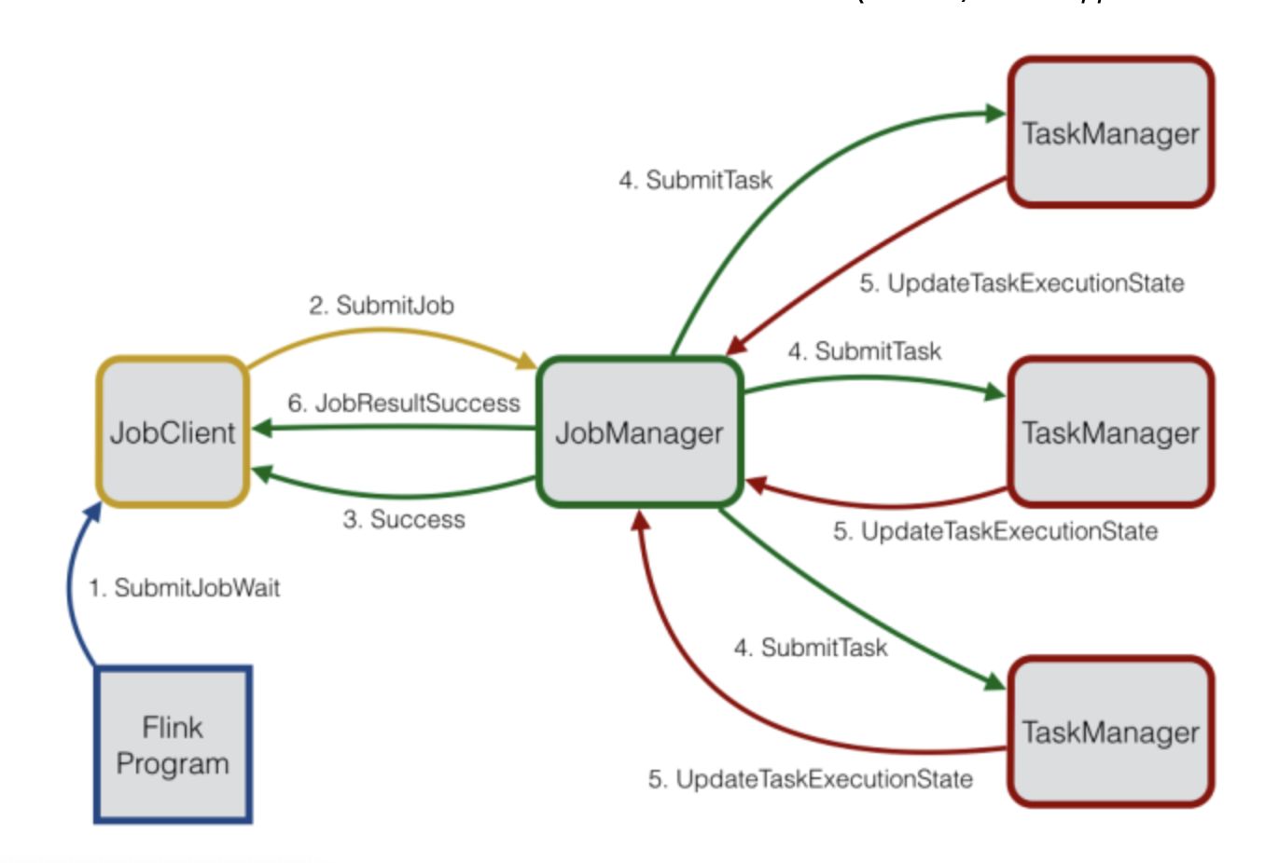
Apache Flink Architecture

Slide 18
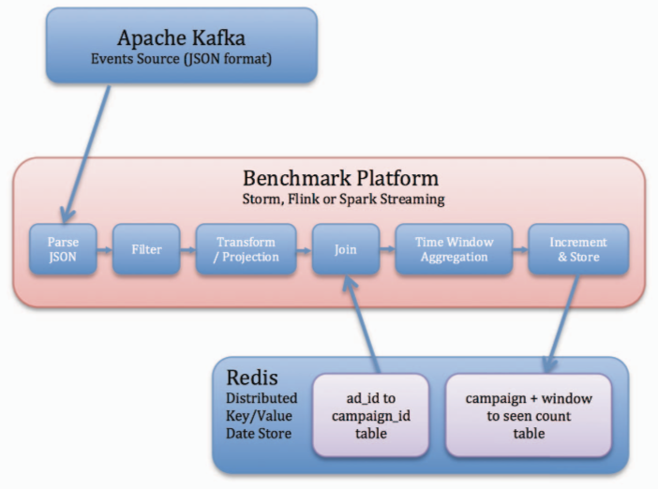
Experiment Design
1. C. Sanket, D. Derek, E. Bobby, F. Reza, G. Thomas, H. Mark, L. Zhuo, N. Kyle, P. Kishorkumar, J. P. Boyang ja P. Paul, „Benchmarking Streaming Computation Engines: Storm, Flink and Spark Streaming.,“ IEEE, 2016.

Slide 19
Comparison with Yahoo Streaming Benchmark
Tools | Yahoo’s version (2015) | My version (2018)
Flink | 1.1.3 | 1.5.0
Spark DStream | 1.6.2 | 2.3.0
Strom | 0.9.7 | 1.2.1
Redis | 3.0.5 | 4.0.8
Kafka Broker | 0.8.2.1 | 0.11.0.2
Spark Structured Streaming | - | 2.3.0
Kafka Stream | - | 1.1.0
Benchmark | Benchmark Metrics | Servers Type | Servers CPU | Servers memory
Yahoo’s version | Latency, Throughput | Dedicated server | 16 cores (8 physical, 16 hyperthreading) | 24GB memory
My Version | Latency, Throughput, Resource Consumption | Virtual Private Server | 16 virtual cores | 32GB memory
GitHub Repository of the project https://github.com/elkhan-shahverdi/streaming-benchmarks
GitHub Repository of the project https://github.com/elkhan-shahverdi/streaming-benchmarks
GitHub Repository of the project https://github.com/elkhan-shahverdi/streaming-benchmarks
GitHub Repository of the project https://github.com/elkhan-shahverdi/streaming-benchmarks
GitHub Repository of the project https://github.com/elkhan-shahverdi/streaming-benchmarks
GitHub Repository of the project https://github.com/elkhan-shahverdi/streaming-benchmarks
GitHub Repository of the project https://github.com/elkhan-shahverdi/streaming-benchmarks

Slide 20
Experiment Topology
10 Stream Processing nodes
5 Kafka nodes
3 Zookeeper nodes
10 Producer nodes
1 Redis node

Slide 21
Experiment Results

Slide 22
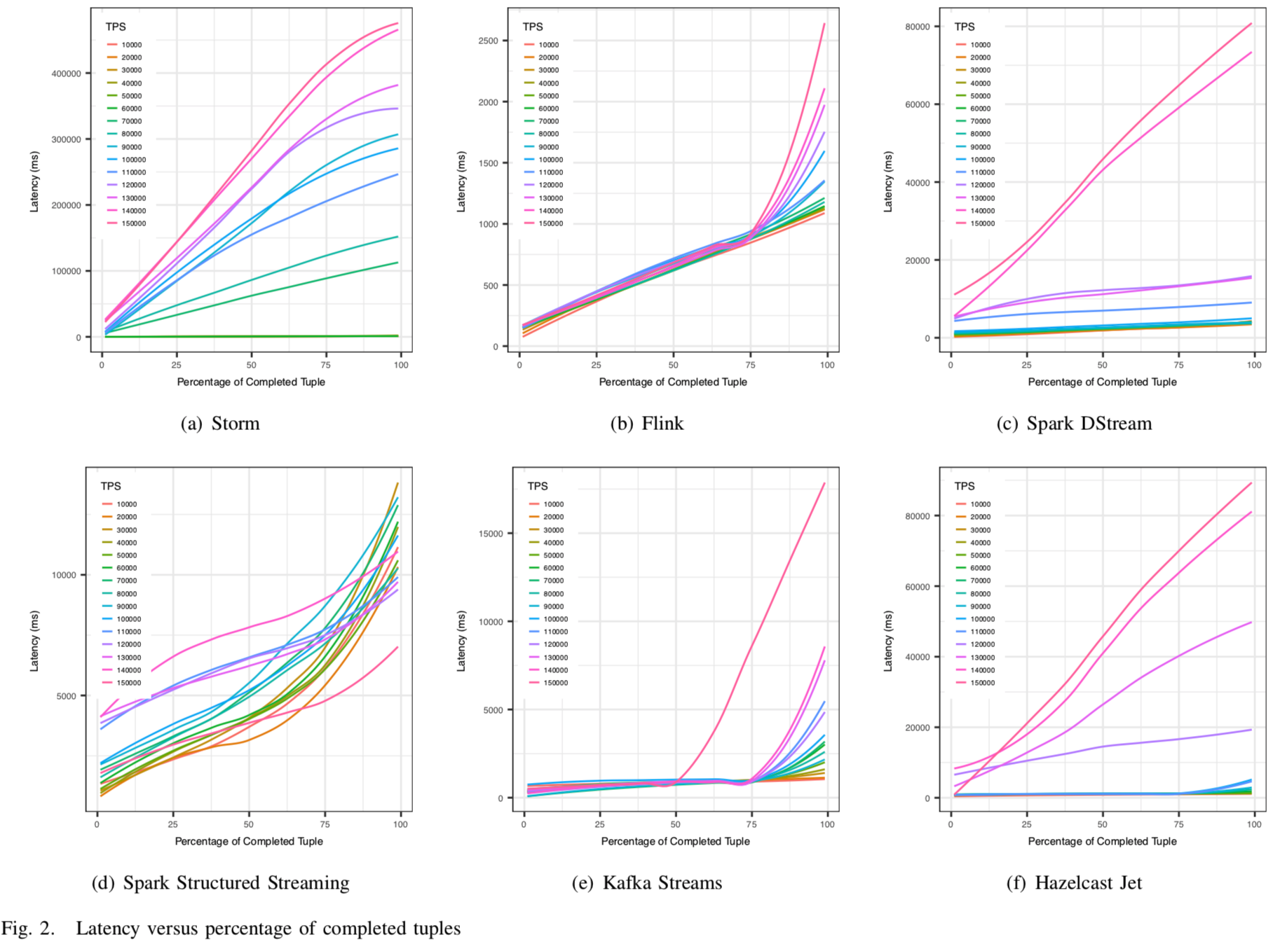

Slide 23
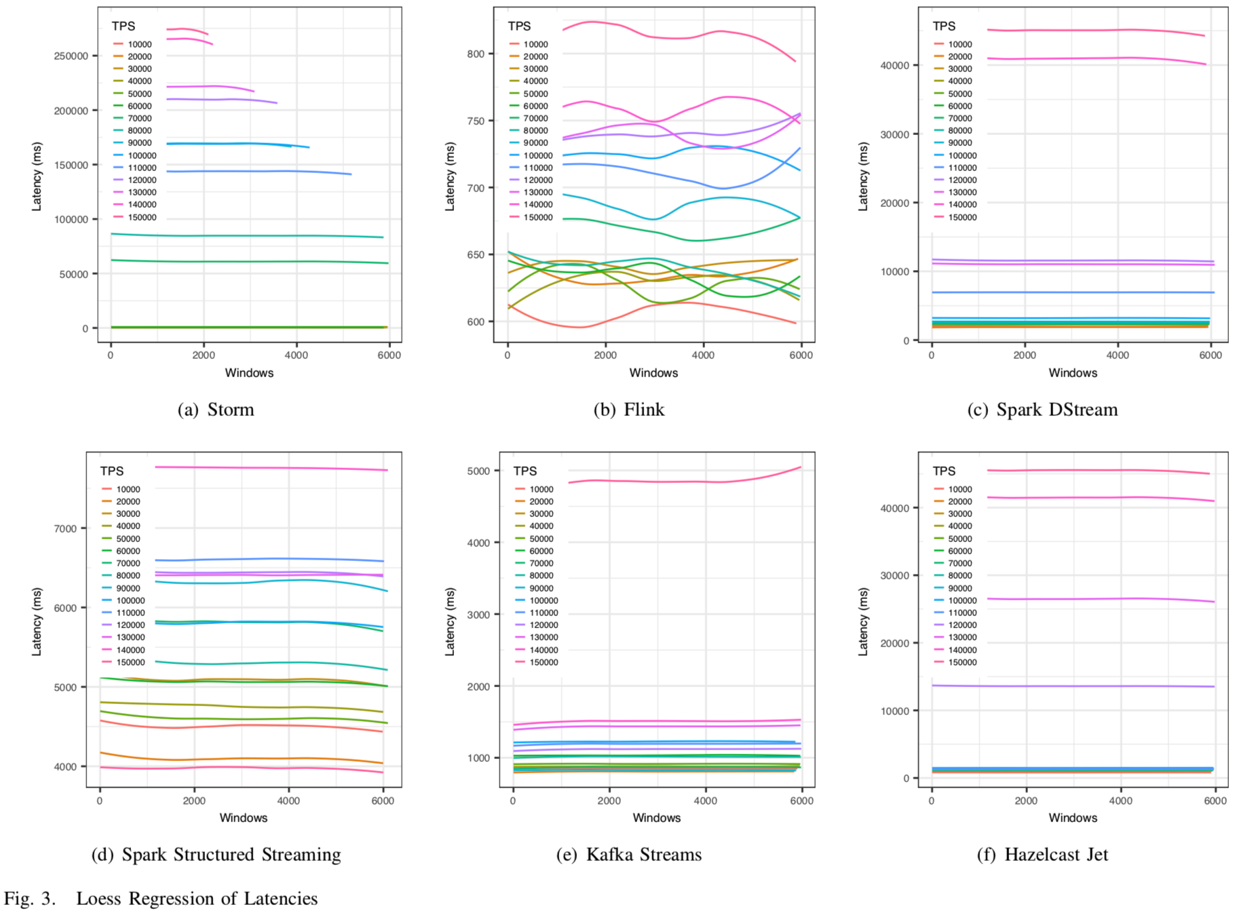

Slide 24
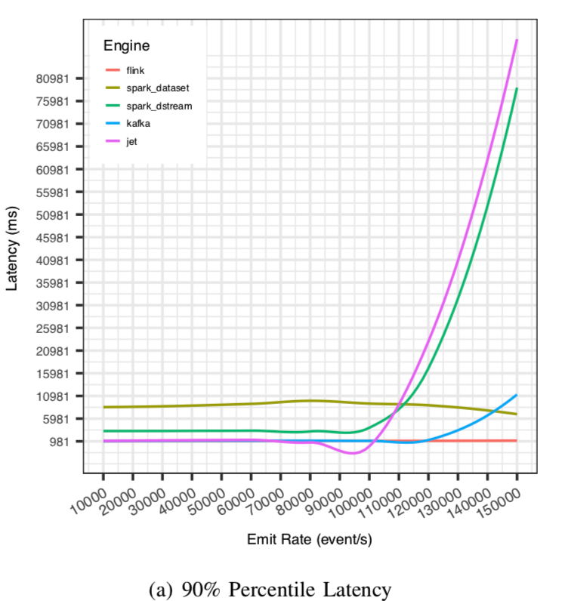
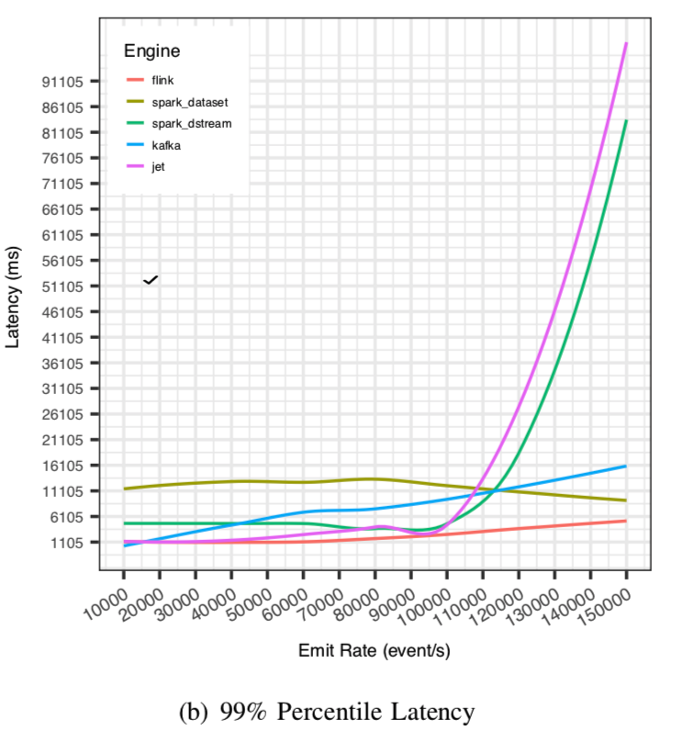

Slide 25
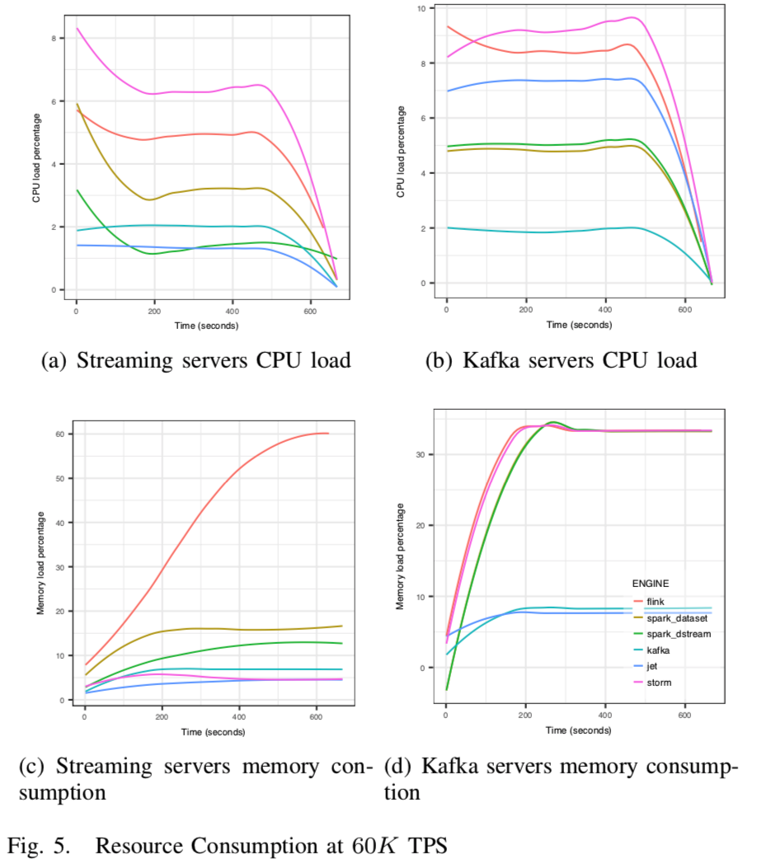

Slide 26
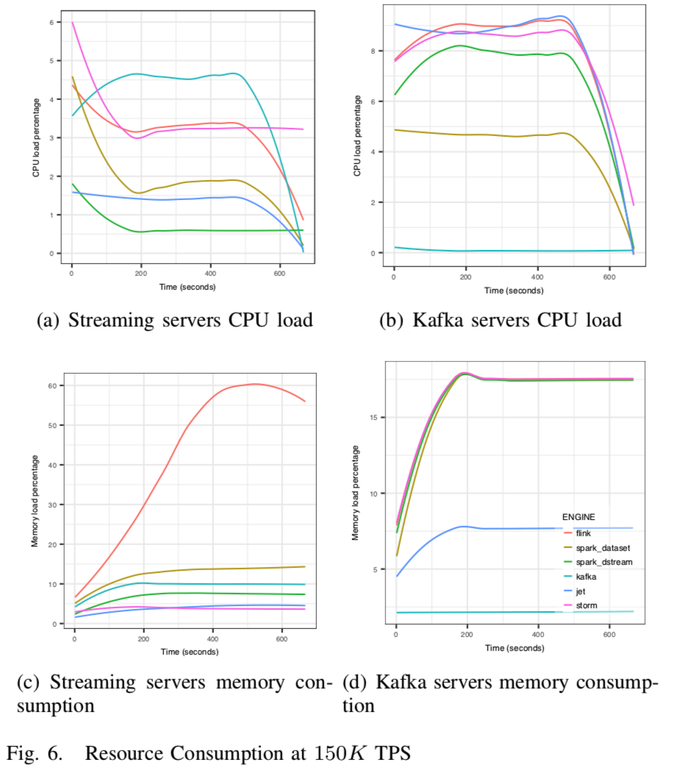

Slide 27
Experiment Conclusion
Flink and Kafka are most noticeable real-time stream processors.
Flink has lower latency than Kafka.
Apache Strom latency can race with Flink with the low amount of data.
Flink custom memory management is not better than Java GC.
Spark Structured Streaming is the more resistant than DStream under huge amount of data.
Flink owes the highest performance for more resource consumptions

Slide 28
Conclusion
Principle is important than tools

Slide 29
References
Big Stream Processing Systems: An Experimental Evaluation by Elkhan Shahverdi, Ahmed Awad, Sherif Sakr
Designing Data-Intensive Applications. By Kleppmann, Martin
Streaming Systems: The What, Where, When, and How of Large-Scale Data Processing. by Tyler Akidau, Slava Chernyak, Reuven Lax
https://cwiki.apache.org/confluence/display/FLINK/Flink+Internals
https://github.com/elkhan-shahverdi/streaming-benchmarks

